Slide 1
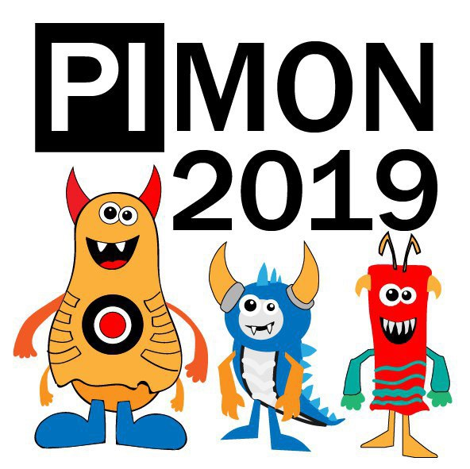
Welcome to 1st PIMON

Slide 2
NO SHIT

Slide 3
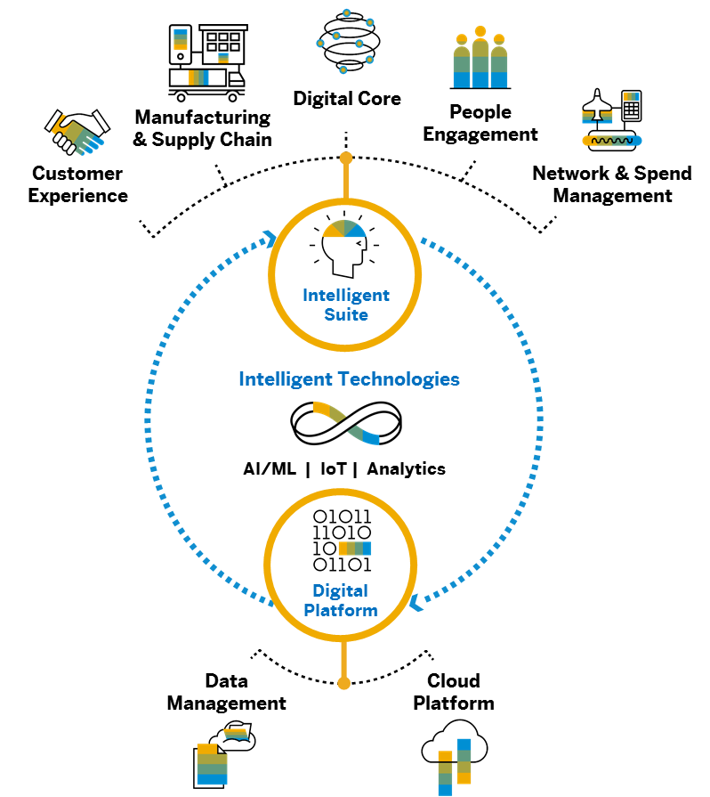




Intelligent Enterprises are Integrated Enterprises
Key Integration Principles
1
2
OUT-OF-THE-BOX
INTEGRATION
OPEN
INTEGRATION
Integration
3
4
HOLISTIC
INTEGRATION
AI-DRIVEN
INTEGRATION

Slide 4
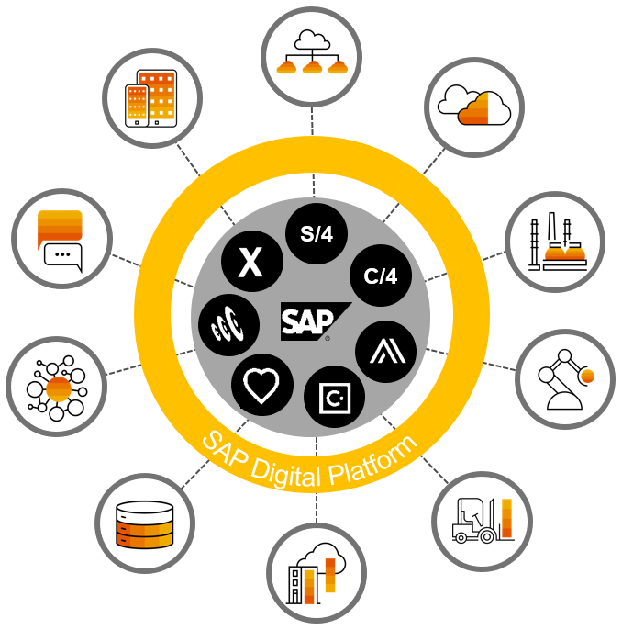
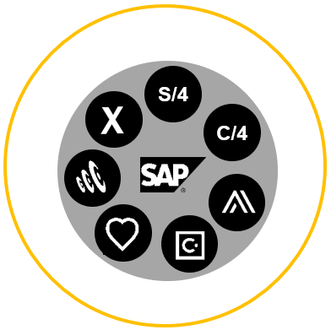
Integration Challenge for the Intelligent Enterprise
Summary: Two Complementary Focus Areas for SAP
SAP Challenge
SAP-to-SAP
IPaaS Challenge
SAP-to-Any | Any-to-Any
Technology Guidance
Technology Guidelines
ISA-M / CIO Guides
SAP continues to deliver out-of-the box integrations for the Intelligent Suite. At the same time, SAP provides strong IPaaS capabilities as part of its business technology platform strategy to serve all integration needs in customer landscapes.
Notes:
// SaaS + attached integration

Slide 5

ENJOY THE PARTY

